Slide 1
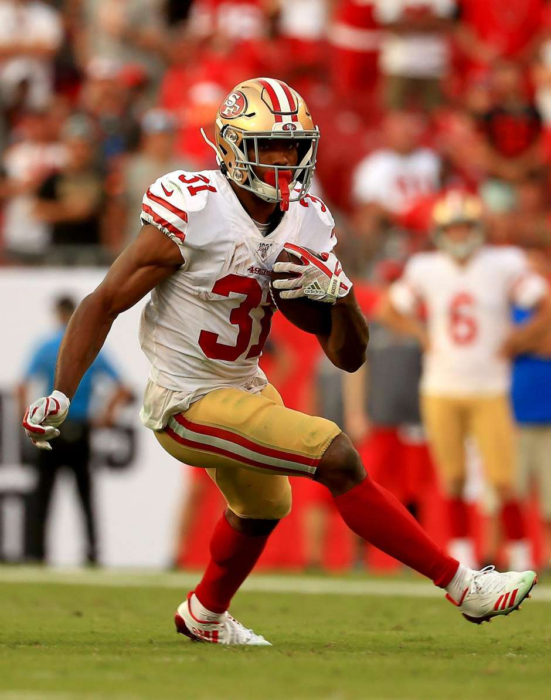
Analyzing the Modern NFL Running Back
Mike Gallaspy and Kevin Kannappan
DSE 241 Final Project Proposal
January 31, 2020
Notes:
https://www.sfchronicle.com/49ers/article/49ers-Raheem-Mostert-ready-to-run-with-latest-14437685.php#photo-18256078

Slide 2
Dataset: Kaggle’s “Big Data Bowl”
NFL’s “Next Gen Stats”
Taken from Kaggle for a competition to predict yards gained
“Running” or “rushing” plays from 2017- mid 2019
Hand-off was made to either a Running Back (RB), Wide Receiver (WR) or Tight End (TE)
Contains rich information:
Player pre-snap X,Y coordinates
Offensive/Defensive Formations
Player acceleration and speed
Play direction and orientation
Play result
Notes:
https://pbs.twimg.com/profile_images/1101207396305690624/69Dqj8zM_400x400.png

Slide 3
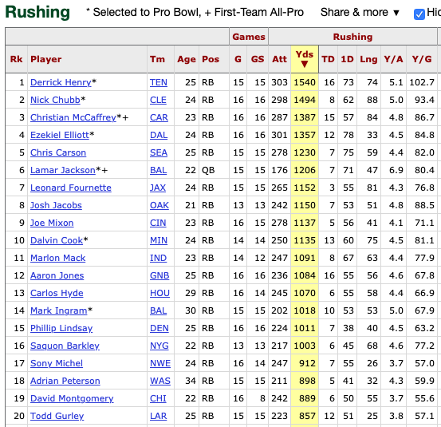
What do we already know about running backs?
Predominately, they “run” or “rush” with the ball to gain yardage to score touchdowns.
Rushing Yards & Touchdowns seem to be primary drivers for Pro Bowl selection
Notes:
https://www.pro-football-reference.com/years/2019/rushing.htm

Slide 4
Text Layout Option: Five columns
Dataset allows for us to visualize the how
Proposed tasks both explore and present new information for analysts and the public alike
1: RB Speed
2: RB Direction
3: Defenses
Who are consistently the fastest RBs?
How well do RBs rush to both sides of the center?
How do defensive formations affect the RB?
4: All together
5: Analysis
Can we see a rich combination of data for RB rushes?
Can we visually propose an alternative hypothesis for Pro Bowl consideration?

Slide 5

01 | 02
Reduce Dataset | Create rush vectors
Create rush-level dataset by dropping peripheral snap-level information | Leverage X, Y coordinates, speed, direction, etc. to develop rush vectors to plot
Pre-requisite steps

Slide 6
Programmatic Solution: Leveraging filtering, sorting and movement
Some theoretical plots & sketches…
Tasks 1 & 2:
Task 3:
Tasks 4 & 5:
May zoom or filter for specific set or specific players. Lines and dots may move.
Notes:
1,2) Complete Dummy Data
3) https://www.kaggle.com/tombresee/next-gen-eda
4,5) https://nextgenstats.nfl.com/charts/list/all/team/season/week/derrick-henry/HEN602843/2019/conference/carry

